Slide 1
Viridien’s Hackathon Challenge
UPSCALING LOW RESOLUTION SATELLITE DATA
Leander Fernandes, Imaging Geophysicist
Ojasvi Sancheti, Senior Machine Learning Engineer
Owen Pape, Recruitment Technical Advisor

Slide 2
Meet the Viridien Team
Leander Fernandes (Geophysicist) leander.fernandes@viridiengroup.com
Joined in 2023 and have been with the company’s Seismic Imaging department for 1.5 years.
Manipulate and process seismic data to produce 3d volumes of the subsurface of the Earth.
Ojasvi Sancheti (Senior Machine Learning Engineer) ojasvi.sancheti@viridiengroup.com
Joined in 2020 and have been part of the AI Lab since then.
Worked with Machine Learning, Deep Learning, and Large Language Models (LLMs) to develop solutions for Computer Vision and Natural Language Processing (NLP) tasks.
Owen Pape (Recruitment Technical Advisor) owen.pape@viridiengroup.com
Joined in 2006 working in Seismic Imaging for 12 years. Started out as a graduate moving to supervising teams.
Last 6 years, working in Operations focused on graduate recruitment and training for Europe, Africa and the Middle East.

Slide 3
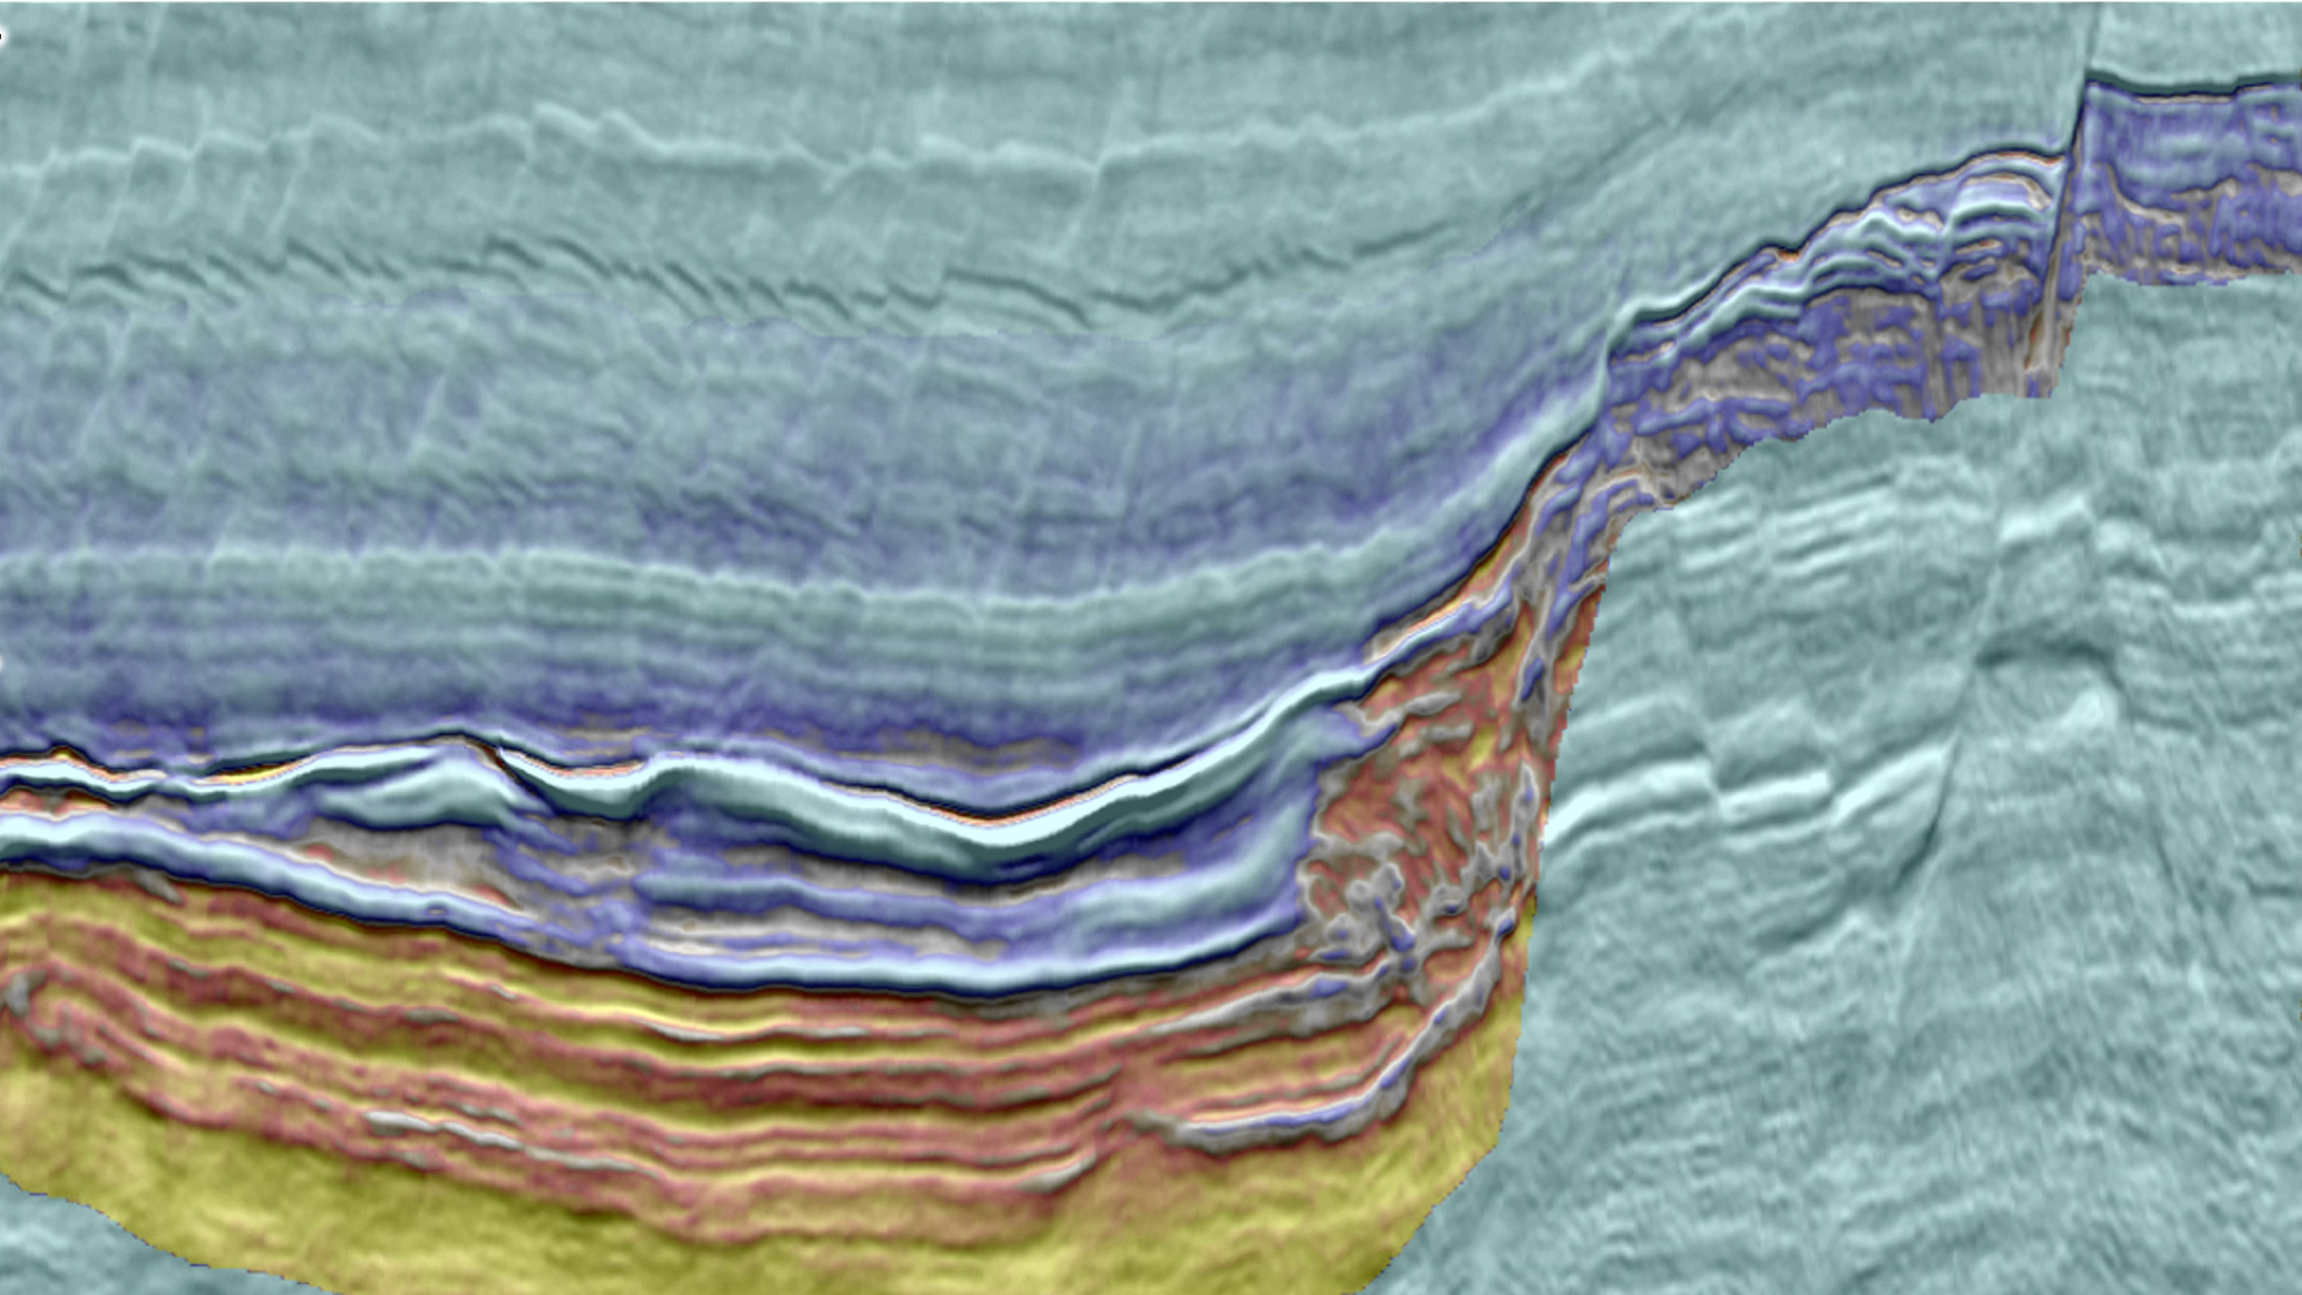
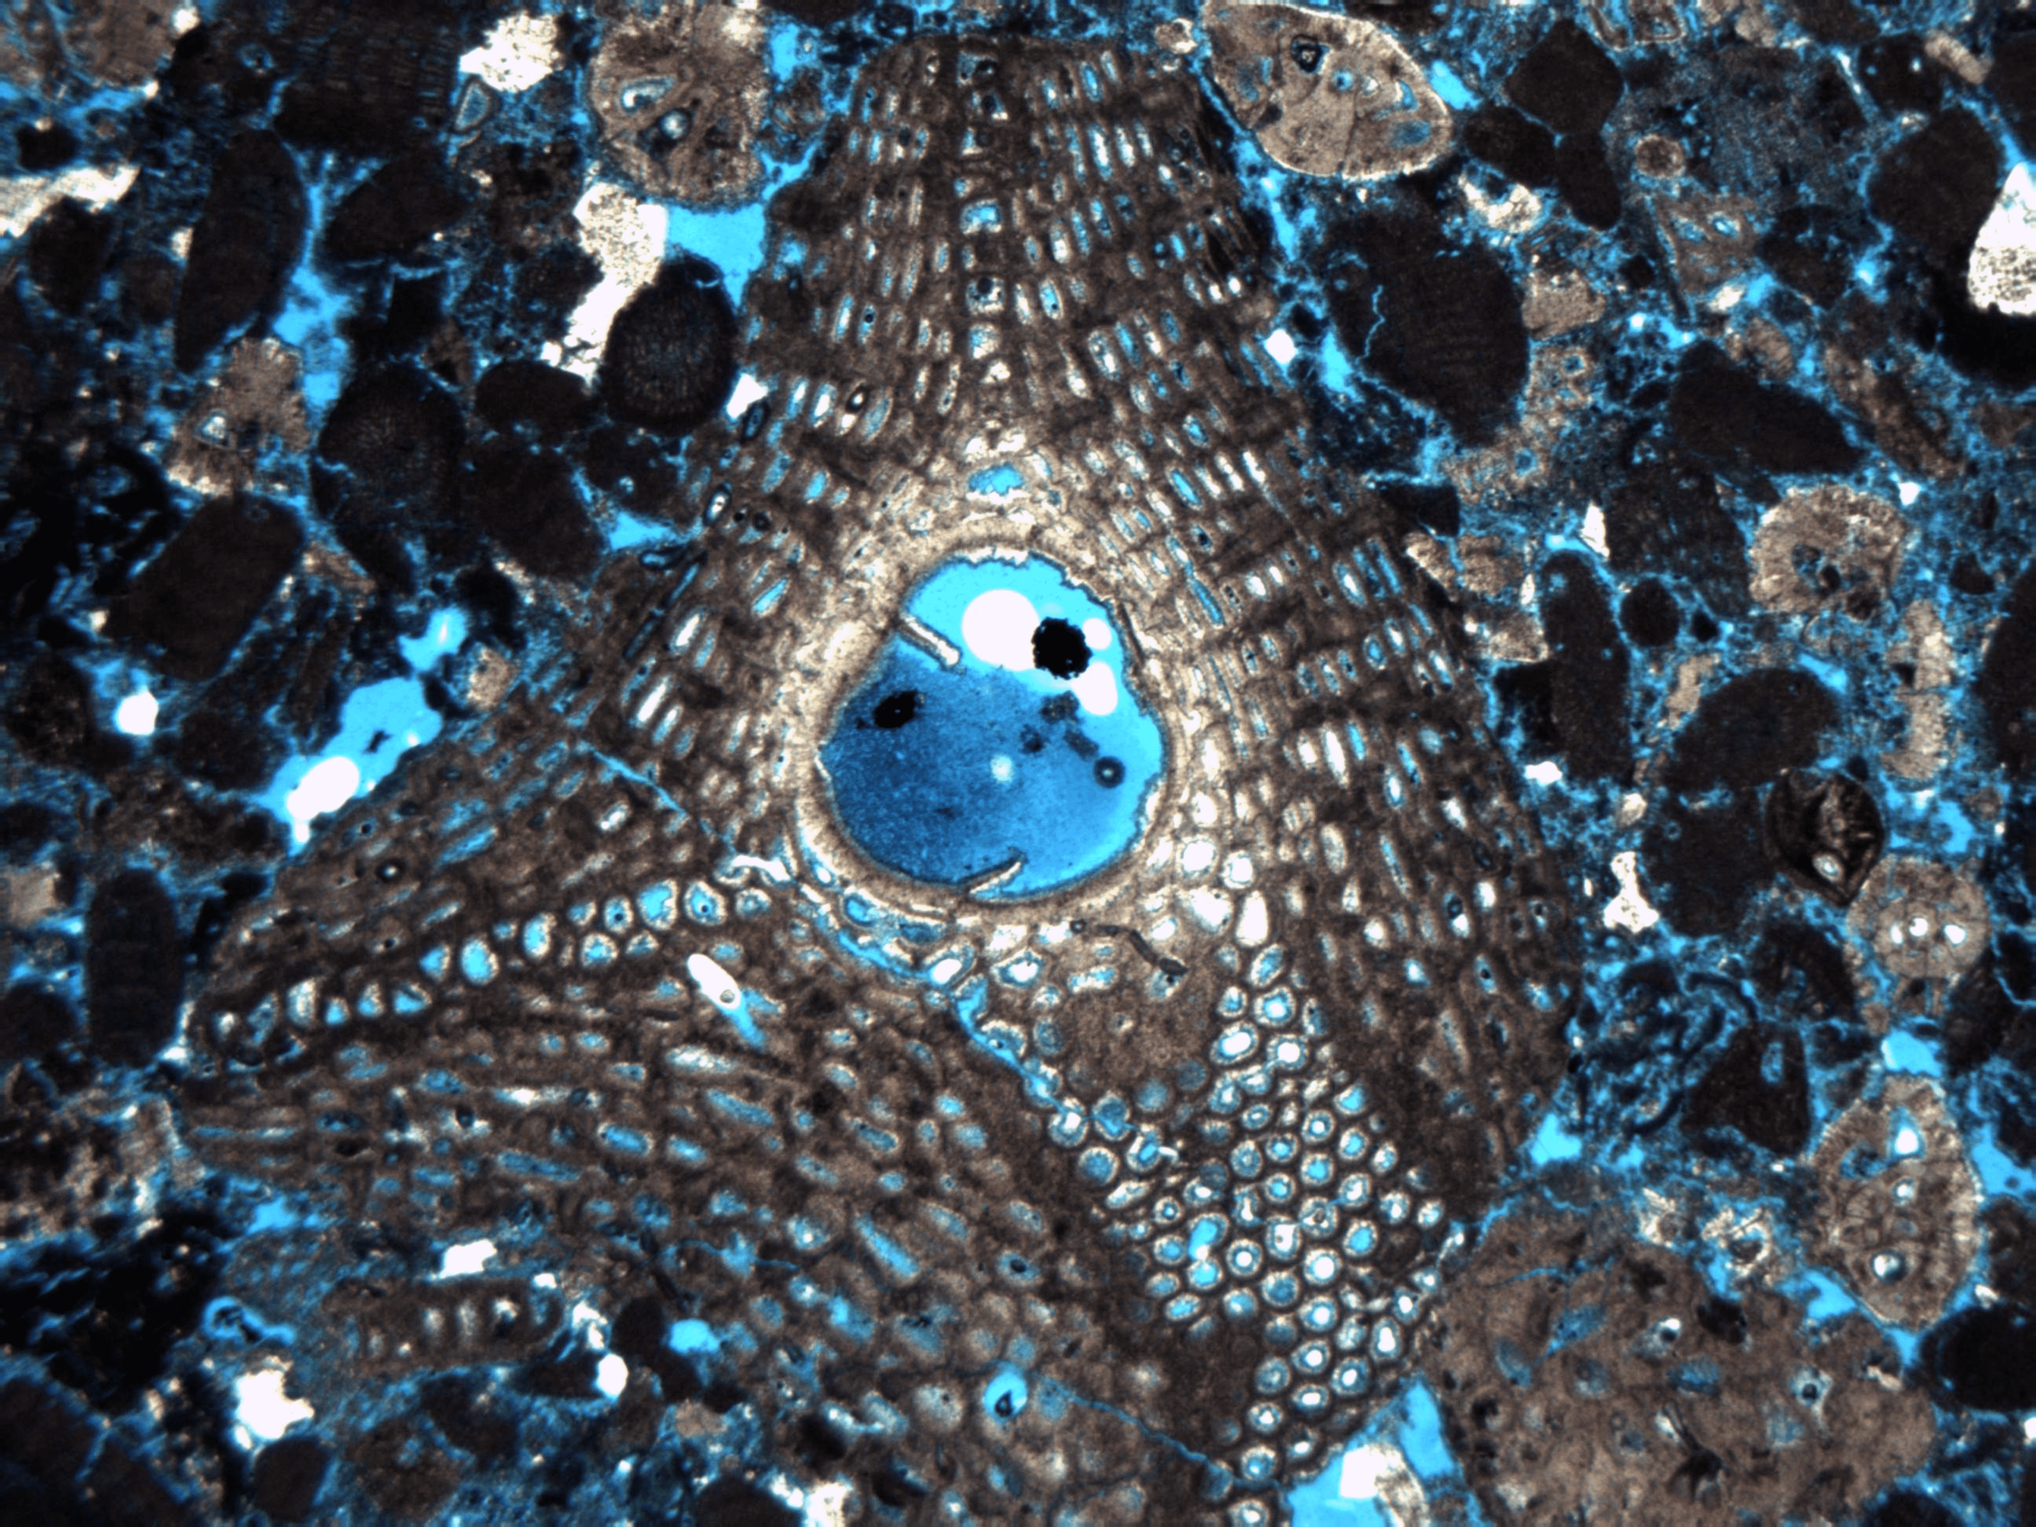

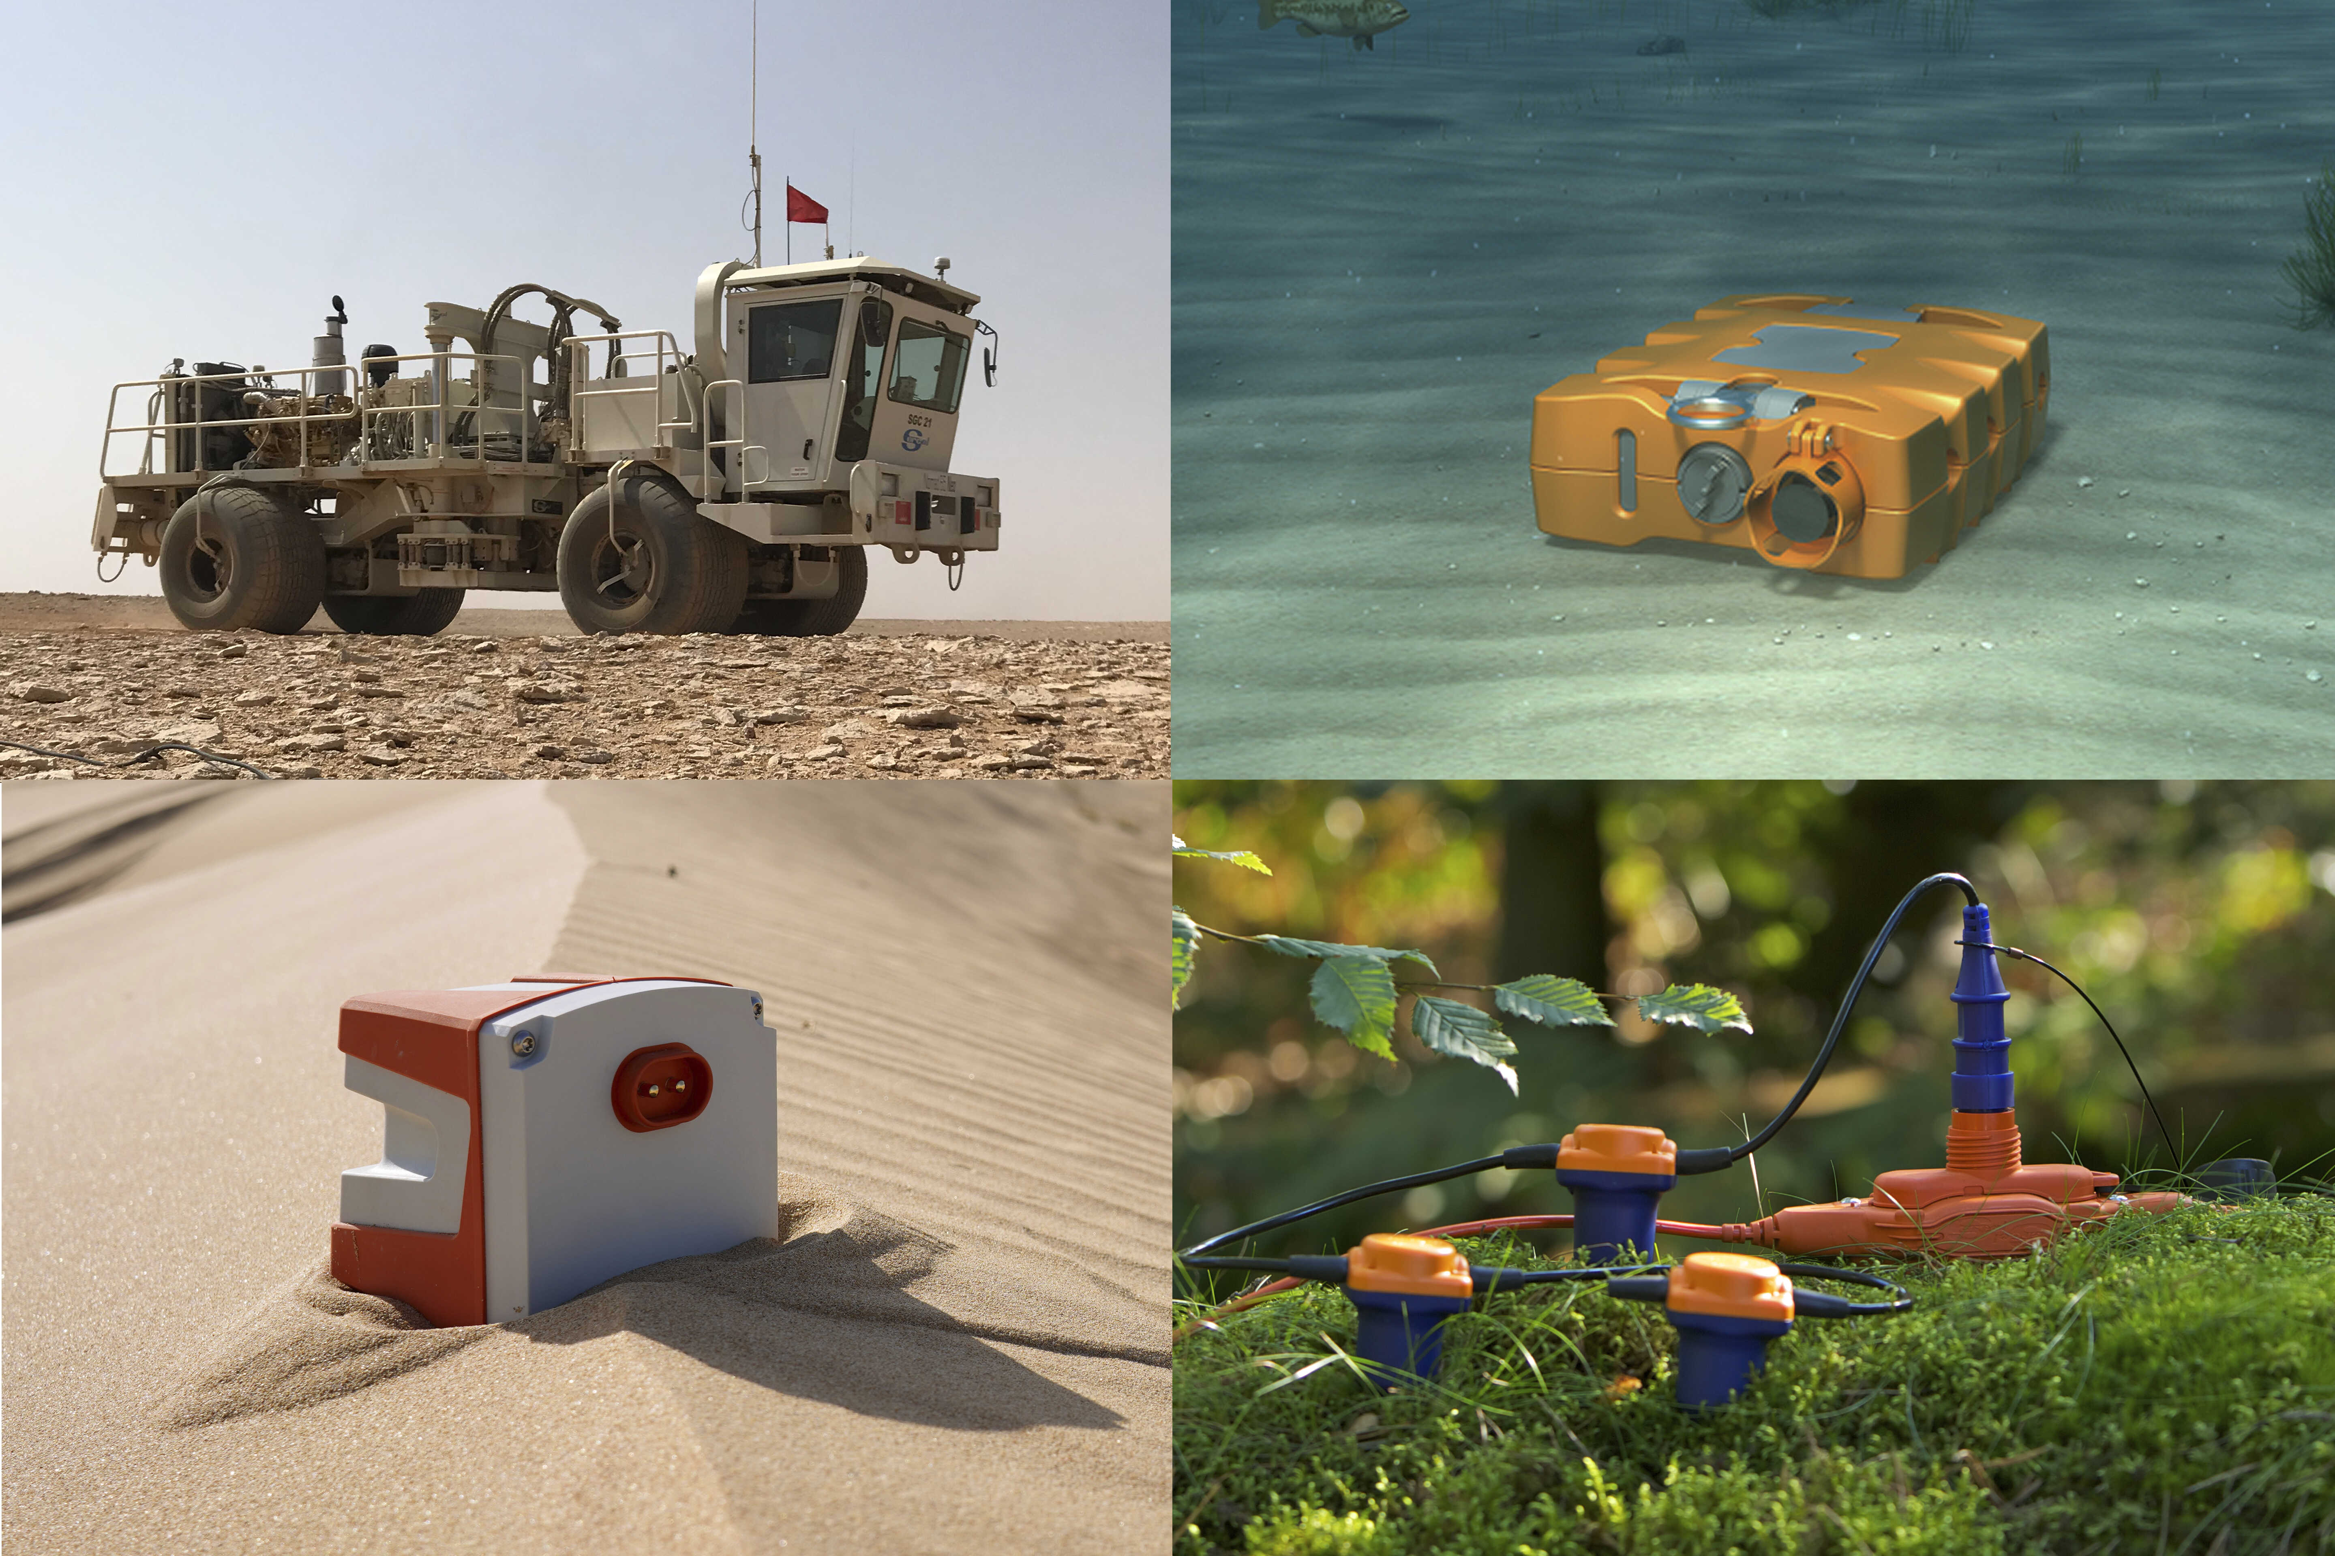
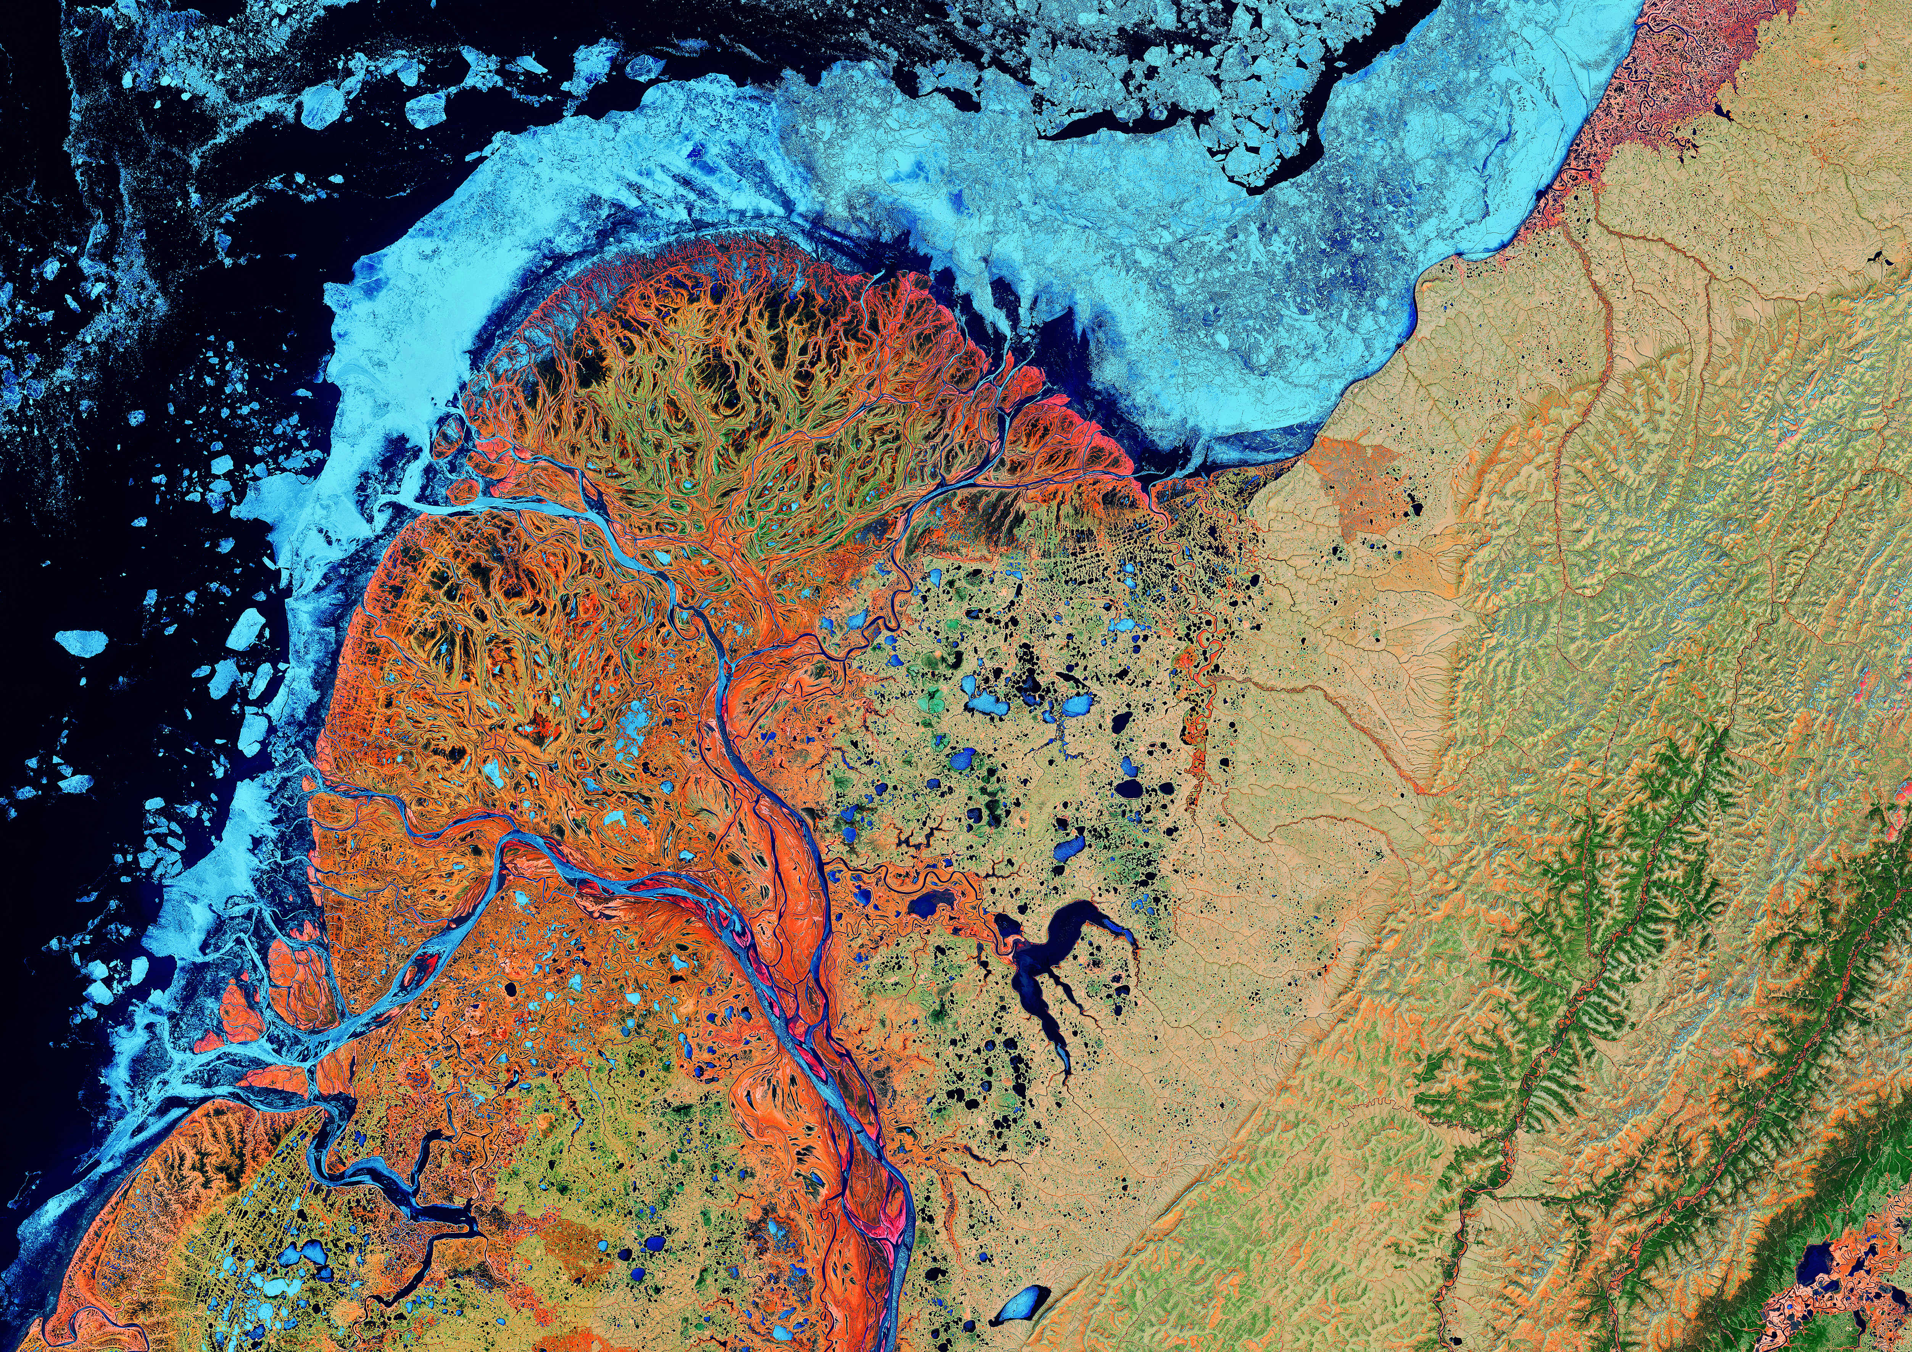
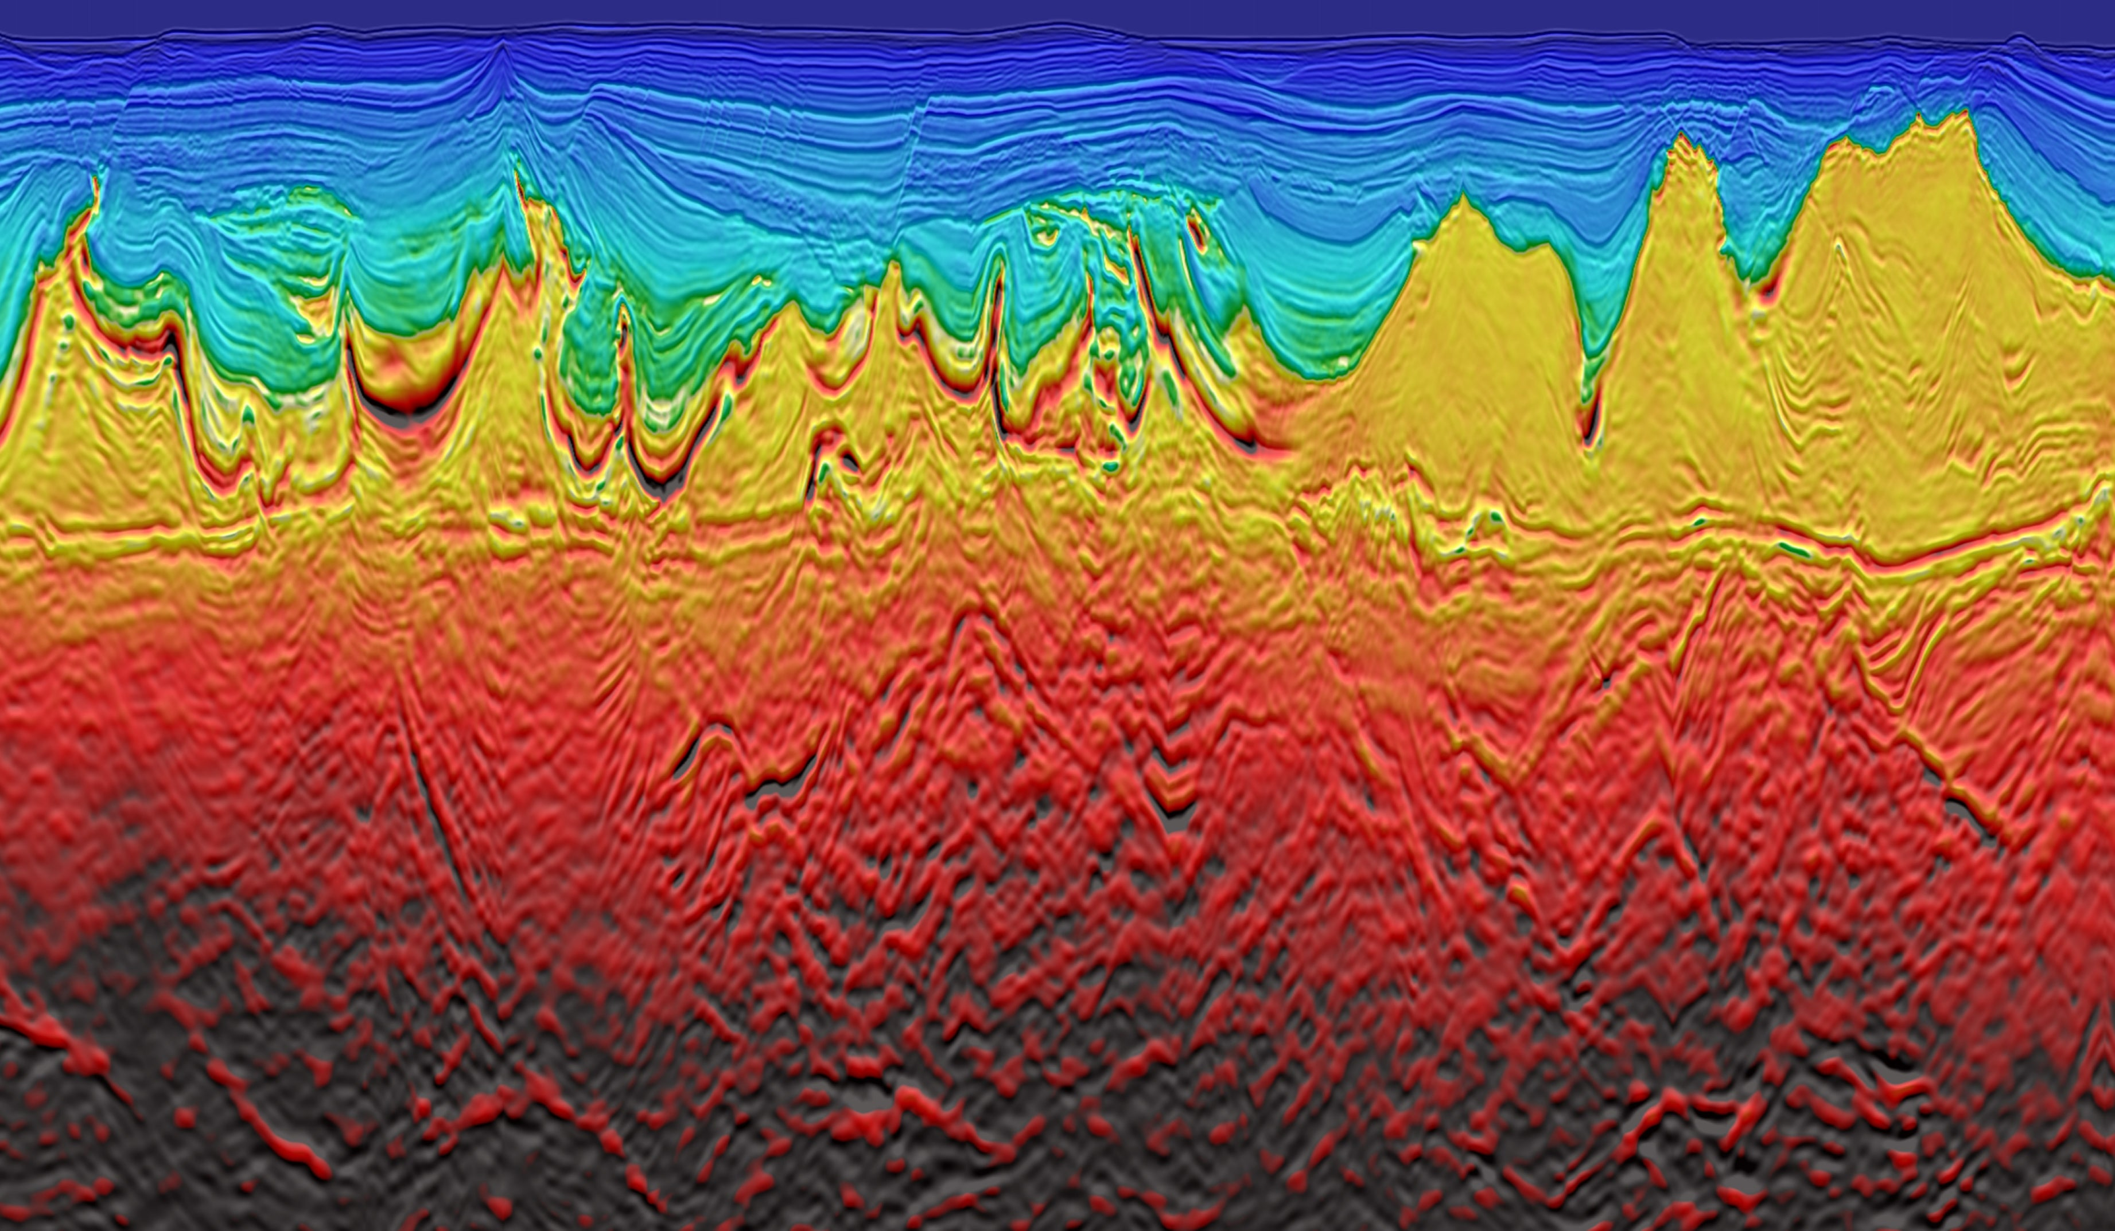
Viridien
Earth Data
Geology & Engineering
HPC Cloud Solutions
Sensing & Monitoring
Satellite Mapping
Seismic Imaging

Slide 4
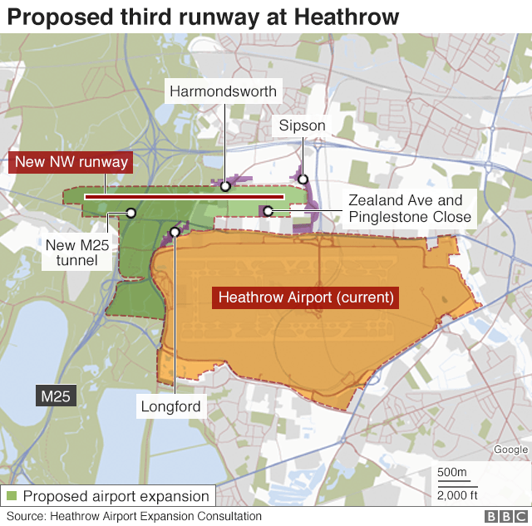
The Context
We’ve seen a lot of talk about expansion of Heathrow airport with a third runway.
As such, there’s a lot of talk about the land NW of Heathrow airport and how expansion is going to affect the area.
We’ve picked up some open-source data of the land sitting between Windsor and Heathrow
Some open questions with the proposal:
How many homes/ businesses are to be acquired?
How is the green belt going to be impacted?
How are waterways going to be impacted?
Land!

Slide 5
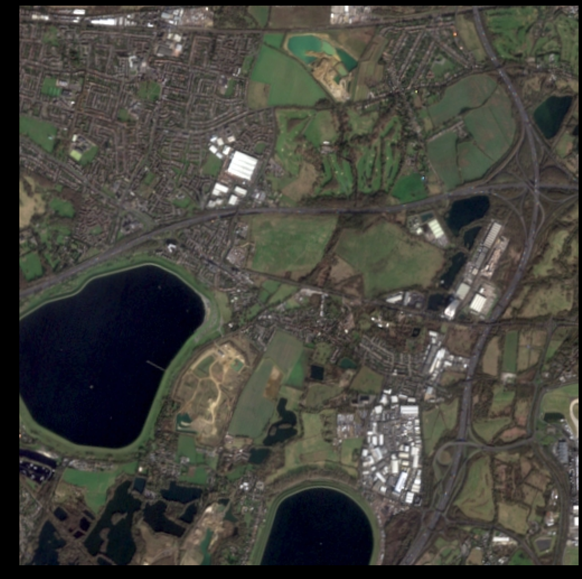

The Data
We are providing you with two data sets looking over land NW of Heathrow airport :
Sentinel data:
3 channel (RGB)
10m x 10m resolution
As TIFF or JPG
Lidar Data
1 channel (elevation)
1m x 1m resolution
As TIFF

Slide 6
Toggle (Satellite)

Slide 7
Toggle (Lidar)

Slide 8
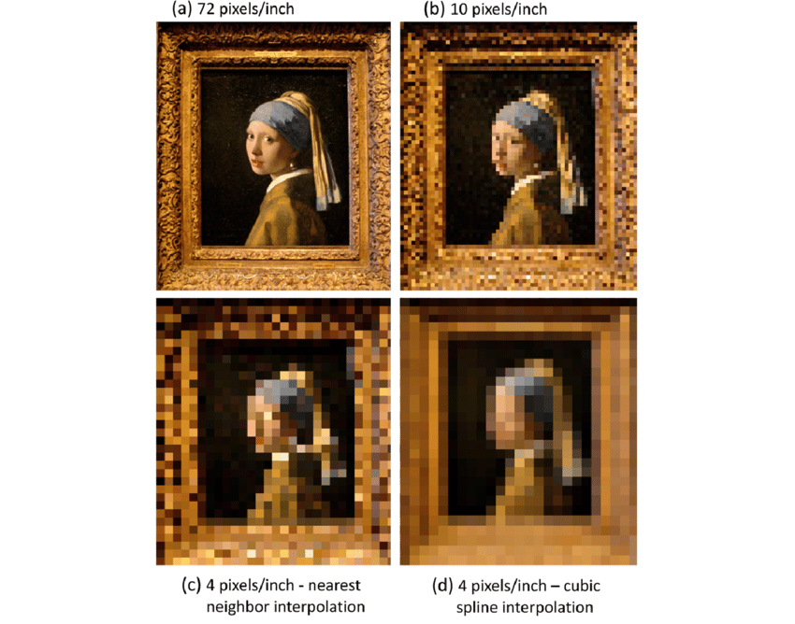
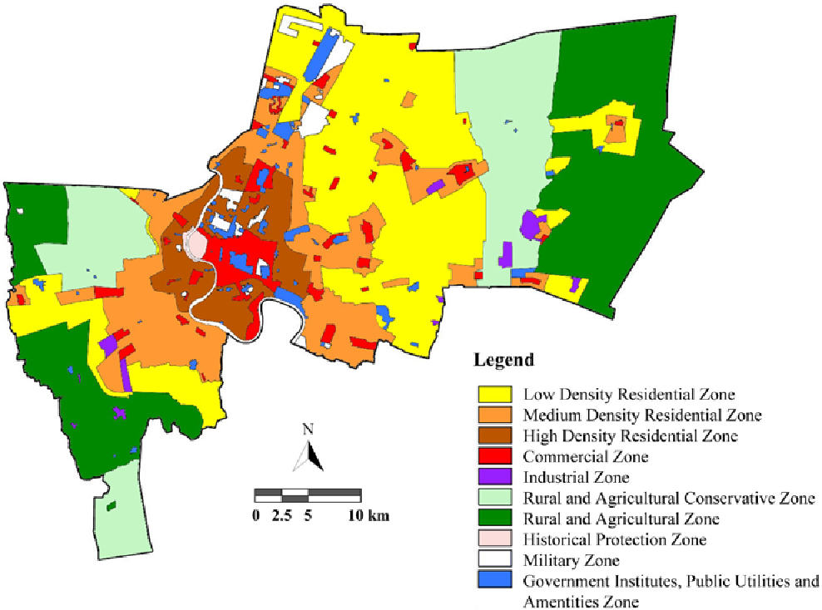

The Challenge
The data here is too interesting to limit you.
Objective 1:
Based on the high resolution lidar data, can you upscale the lower resolution satellite data?
Objective 2:
Based on the datasets provided, can you classify land use?

Slide 9
What we’re looking for
Try to find innovative solutions to the proposed objectives.
We’ll be looking for things like:
Algorithms implemented (how robust are they, what are their limitations)
Do upscaled images look realistic (compare them to images from google map).
Any interesting findings on land use and likely impact of a third runway.
How resource intensive is your solution?
Blind testing.

Slide 10
Good luck!!

